Slide 1
Z1146 - ENTREPRENEURSHIP II
SESSION X
BUSINESS MODEL PATTERNS

Slide 2
Learning Objectives
LO 1 : Creating an innovative business model

Slide 3
Overview

Slide 4
Business Model Patterns
Business models with similar characteristics, similar arrangements of business model Building Blocks, or similar behaviors.
Business Model
Patterns

Slide 5
5 Business Model Patterns
Unbundling Business Model
The Long Tail
Multi-sided Platforms
FREE as a Business Model
Open Business Models

Slide 6
Patterns

Slide 7
Unbundling Business Model
The concept of the “unbundled” corporation holds that there are three fundamentally different types of businesses: Customer Relationship businesses, product innovation businesses, and infrastructure businesses.
Each type has different economic, competitive, and cultural imperatives.
The three types may co-exist within a single corporation, but ideally they are “unbundled” into separate entities in order to avoid conflicts or undesirable trade-offs.

Slide 8
Unbundling Business Model
 | Product Innovation | Customer Relationship Management | Infrastructure Management
Economics | Early market entry enables charging premium prices and acquiring large market share; speed is key | High cost of customer acquisition makes it imperative to gain large wallet share; economies of scope are key | High fixed costs make large volumes essential to achieve low unit costs; economies of scale are key
Culture | Battle for talent; low barriers to entry; many small players thrive | Battle for scope; rapid consolidation; a few big players dominate | Battle for scale; rapid consolidation; a few big players dominate
Competition | Employee centered; coddling the creative stars | Highly service oriented; customer comes- first mentality | Cost focused; stresses standardization, predictability, and efficiency

Slide 9
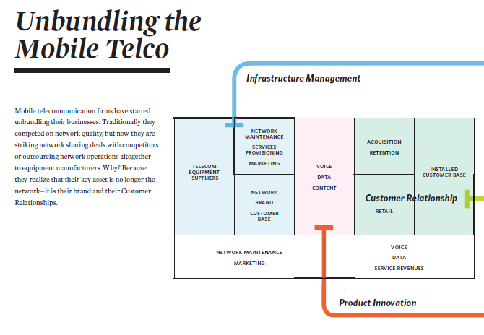
Unbundling the Mobile Telco

Slide 10
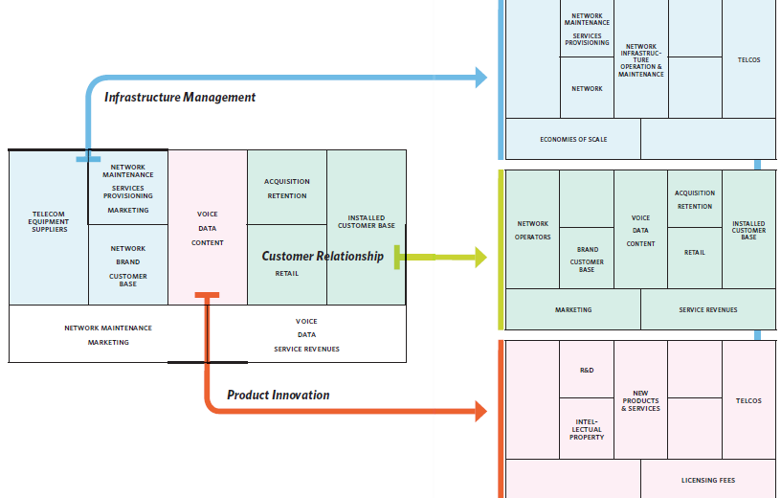
Unbundling the Mobile Telco

Slide 11
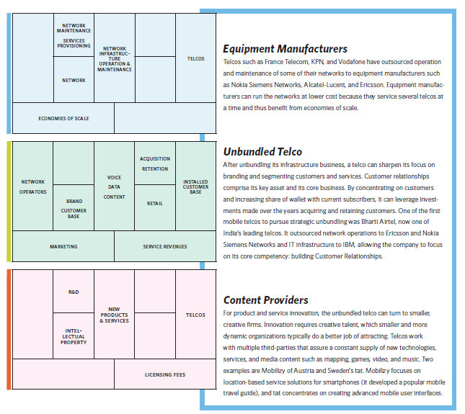
Unbundling the Mobile Telco

Slide 12
The Long Tail
Long tail business models are about selling less of more: They focus on offering a large number of niche products, each of which sells relatively infrequently.
Aggregate sales of niche items can be as lucrative as the traditional model whereby a small number of bestsellers account for most revenues.
Long Tail business models require low inventory costs and strong platforms to make niche content readily available to interested buyers.

Slide 13
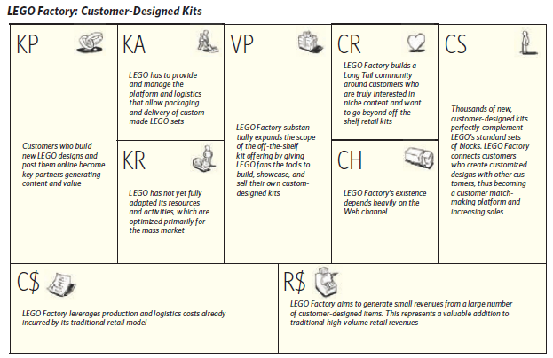
The Long Tail

Slide 14
Multi-sided Platforms
Multi-sided platforms bring together two or more distinct but interdependent groups of customers.
Such platforms are of value to one group of customers only if the other groups of customers are also present.
The platform creates value by facilitating interactions between the different groups.
A multi-sided platform grows in value to the extent that it attracts more users, a phenomenon known as the network effect.

Slide 15
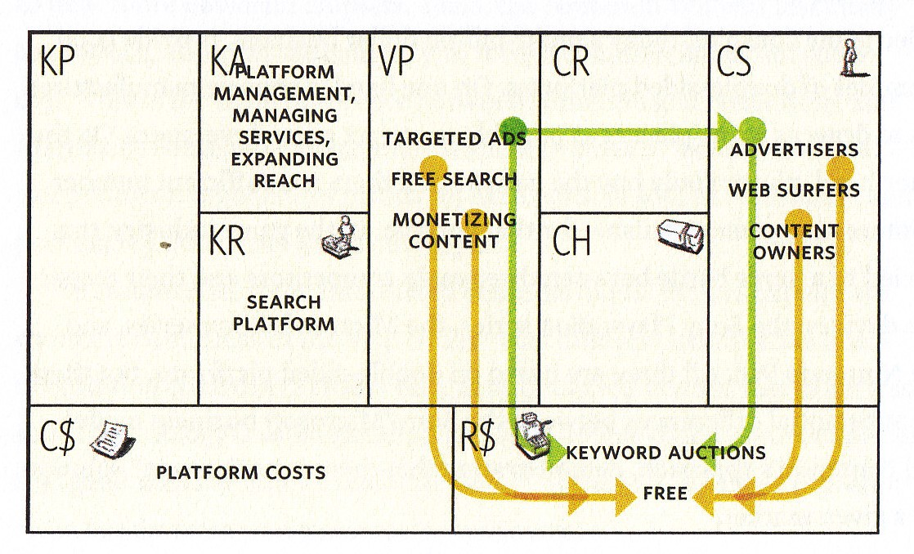
Google Multisided Platform

Slide 16
FREE as a Business Model
In the free business model at least one substantial Customer Segment is able to continuously benefit from a free-of-charge offer.
Different patterns make the free offer possible.
Non-paying customers are financed by another part of the business model or by another Customer Segment.

Slide 17
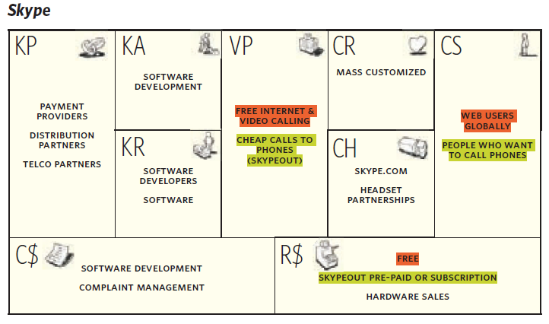
Skype’s Free Business Model

Slide 18
Open Business Model
Open business models can be used by companies to create and capture value by systematically collaborating with outside partners.
This may happen from the “outside-in” by exploiting external ideas within the firm, or from the “inside-out” by providing external parties with ideas or assets lying idle within the firm.

Slide 19
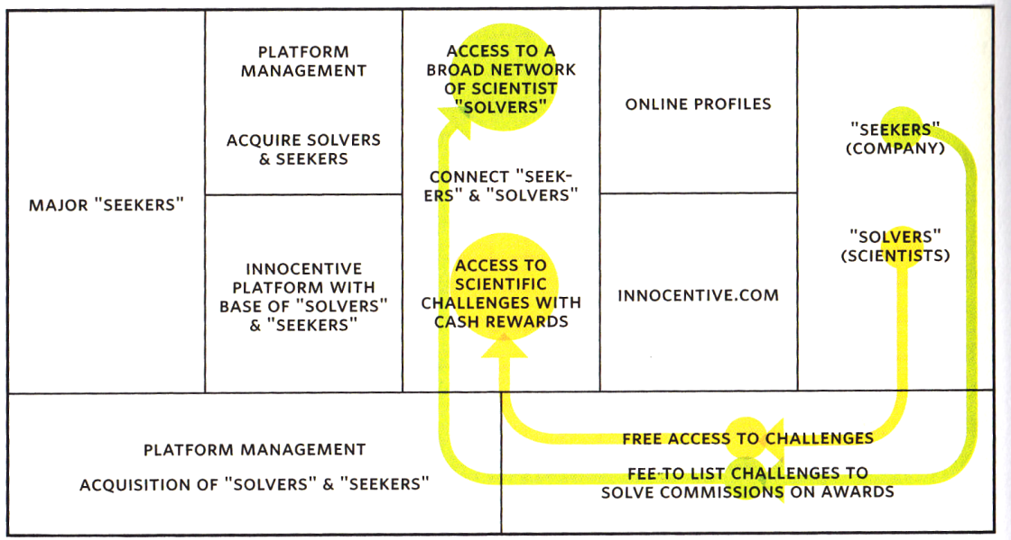
Innocentive Open Business Model

Slide 20
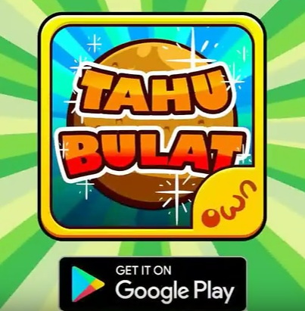
Case
Tahu Bulat by Own Games
https://youtu.be/XycYaYxD6FI
Which kind of business model pattern is used by Tahu Bulat game?

Slide 21
References
Osterwalder, A., & Pigneur, Y. (2010). Business model generation: a handbook for visionaries, game changers, and challengers. John Wiley & Sons.

